Slide 1
The Lancet-UiO Commission: Building Commitments and Accelerating Progress
The political relevance
Sigrun Møgedal 17.10.13

Slide 2
Our Entry Points for Building Commitments
Democratization of global governance – more space for inclusive processes
More inter-connected governance – overcoming fragmentation across sectors and policy processes
The need for independent monitoring and strengthened accountability to people
Available instruments – human rights, judicial system, solidarity and shared responsibility

Slide 3
Policy Context, Post-2015 Global Development
A paradigm shift:
towards a transformative and universal global development agenda,
sufficiently flexible to respond to the unique political, social, economic and ecological transformation imperatives facing countries and regions
Calls for
inclusive, human centered and rights-based global governance
integrated and interconnected approach to the political economy, social justice and ecological agendas

Slide 4
Need for New Institutional Responses
Committee on Food Security associated with FAO
New arenas for inclusive participation of civil society in several multilateral institutions
UN architecture for sustainable development in the making, associated with ECOSOC
NCD Coordinating Mechanism debated – need more ”space” than what is offered by WHO
Governance reveals competing interests and interest-groups
Hard job to create new institutions

Slide 5
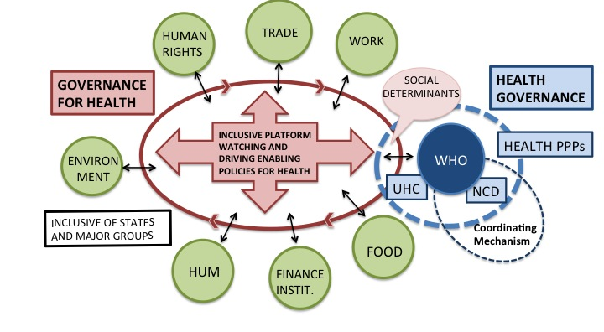
Towards More Inclusive and Interconnected Governance for Health

Slide 6
Independent Monitoring
Growing interest in and awareness of the need for better data and better oversight mechanisms in global health and development
Appropriate measurement of governance and human rights commitments is feasible and desirable, at global, national and local levels.
Political determinants of health and health inequities are measurable and must be lifted up as a global governance responsibility
If we have an independent scientific panel on climate and biodiversity, why not for the political determinants of health and sustainable wellbeing
Can the global academic community respond?

Slide 7
Making Existing Instruments Better Serving Health
Human rights instruments –
The Convention of the Rights of the Child
the role of the UN Special Rapporteurs (”Right to Health”, )
Impact assessment – learning from environmental impact, positive and negative
Accountability for protection of health – stronger mechanisms for Corporate Sector responsibilities
Global solidarity – beyond aid – move towards mandatory, assessed contributions and shared responsibility

Slide 8
Making the Case Across Governments
Foreign Policy and Global Health processes as vehicles for dialogue – health as a shared objective
Employment and Social protection basic to deals on sustainable development
Growing interest in health diplomacy – access to medicines, regulations to protect health
Policy coherence – as far as it can take us
Managing risks to health and health insecurity
Major question – readiness for change? Global, regional or coalition of the willing? Who will gain?

Slide 9
Mobilising Demand for Change
Approach to change will
need to maximise opportunities in relation to on-going policy processes
seek joint and convergent action across multiple actors and stakeholders
make convincing sense as response to agreed problems
be incremental and pragmatic
Change will not come from within establishment (institutional stickiness), - need change agents!

